Slide 1
2050 Regional Transportation Plan
Purpose of RTP:
  Identify the transportation guiding principles & goals for the region
  Identify transportation investments through 2050
Implement community-based process
Plan completion by May 2021
  Draft for review in Fall 2020
Notes:
Safety Improvements – Complete Streets can improve vehicular and pedestrian safety through the introduction of traffic calming measures such as raised medians and narrower travel lanes.
Improved Mode Choice – Complete Streets tends to implement a more connected network for transit riders, pedestrians and cyclists, which improves the chances that people choose alternative modes of transportation over single occupancy vehicles.
Economic Growth – a complete street network promotes economic vitality and growth by providing better and safer access to community destinations, including residences, schools, commercial areas, and parks.
Public Health – by implementing and promoting walking and cycling improvements, the Complete Streets policy promotes active movement, which can help to reduce the obesity epidemic and support an aging population.
Reduced Congestion – by implementing and promoting alternative transportation choices, Complete Streets tend to alleviate congestion by distributing travelers amongst many modes.
Improved Air Quality – by promoting alternative trip choices, Complete Streets can have the effect of removing congestion producing single occupancy vehicle trips, helping to ease pollution concerns and promote a safer environment for travel.

Slide 2
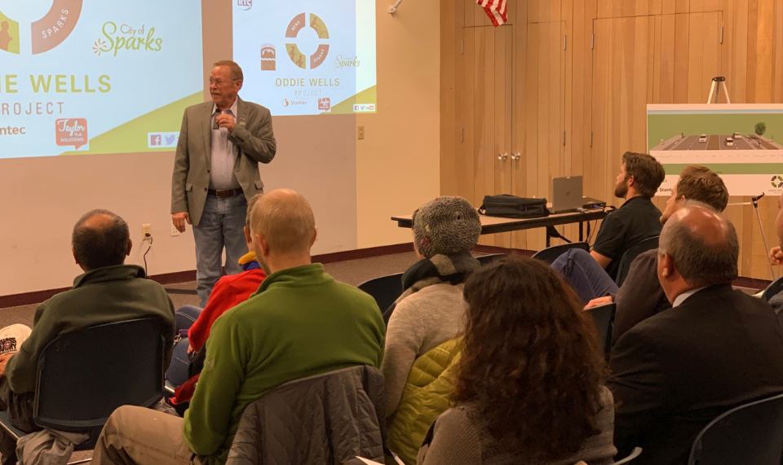
Public & Agency Outreach Process
Presentations to Reno, Sparks, Washoe County & other regional boards
Monthly updates to RTC Board & TAC/CMAC
Agency Working Group
Inter-County Transportation Working Group
Community Planning Workshops
Social Media/Traditional Media
Notes:
Safety Improvements – Complete Streets can improve vehicular and pedestrian safety through the introduction of traffic calming measures such as raised medians and narrower travel lanes.
Improved Mode Choice – Complete Streets tends to implement a more connected network for transit riders, pedestrians and cyclists, which improves the chances that people choose alternative modes of transportation over single occupancy vehicles.
Economic Growth – a complete street network promotes economic vitality and growth by providing better and safer access to community destinations, including residences, schools, commercial areas, and parks.
Public Health – by implementing and promoting walking and cycling improvements, the Complete Streets policy promotes active movement, which can help to reduce the obesity epidemic and support an aging population.
Reduced Congestion – by implementing and promoting alternative transportation choices, Complete Streets tend to alleviate congestion by distributing travelers amongst many modes.
Improved Air Quality – by promoting alternative trip choices, Complete Streets can have the effect of removing congestion producing single occupancy vehicle trips, helping to ease pollution concerns and promote a safer environment for travel.

Slide 3
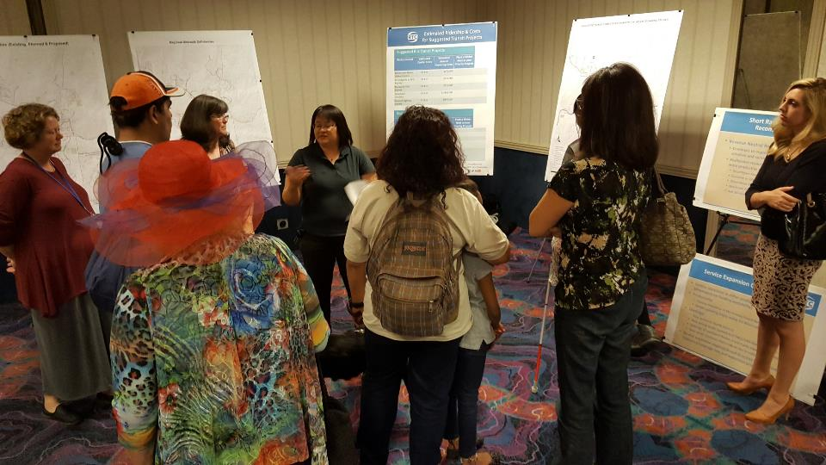
2050 Regional Transportation Plan
Public & Agency Outreach Process
Issue-Based Workshops/Roundtables
  Sparks Industrial Roadway Network Analysis
  Transportation Safety
  Youth Transportation Issues
  Economic Development
  Transit Vision
  Downtown Reno Circulation
  North Valleys Roadway Network Expansion
Notes:
Safety Improvements – Complete Streets can improve vehicular and pedestrian safety through the introduction of traffic calming measures such as raised medians and narrower travel lanes.
Improved Mode Choice – Complete Streets tends to implement a more connected network for transit riders, pedestrians and cyclists, which improves the chances that people choose alternative modes of transportation over single occupancy vehicles.
Economic Growth – a complete street network promotes economic vitality and growth by providing better and safer access to community destinations, including residences, schools, commercial areas, and parks.
Public Health – by implementing and promoting walking and cycling improvements, the Complete Streets policy promotes active movement, which can help to reduce the obesity epidemic and support an aging population.
Reduced Congestion – by implementing and promoting alternative transportation choices, Complete Streets tend to alleviate congestion by distributing travelers amongst many modes.
Improved Air Quality – by promoting alternative trip choices, Complete Streets can have the effect of removing congestion producing single occupancy vehicle trips, helping to ease pollution concerns and promote a safer environment for travel.

Slide 4
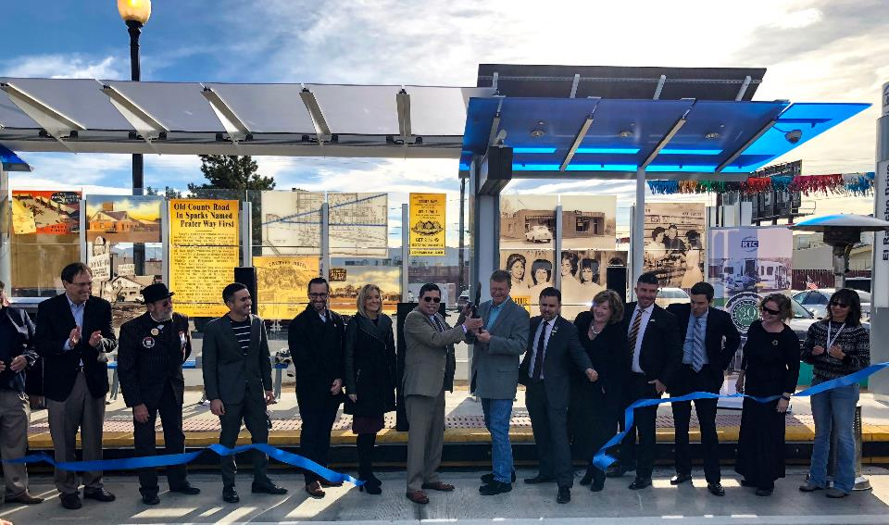
Major Sparks Projects in Current Plan
Completed Projects
  SouthEast Connector
  Pyramid/McCarran Intersection
  4th Street/Prater Way BRT
Projects In Development
  Oddie/Wells
  Pyramid Highway
  Sparks Boulevard
  I-80 Widening
  Pyramid/US 395 Connector
Notes:
Safety Improvements – Complete Streets can improve vehicular and pedestrian safety through the introduction of traffic calming measures such as raised medians and narrower travel lanes.
Improved Mode Choice – Complete Streets tends to implement a more connected network for transit riders, pedestrians and cyclists, which improves the chances that people choose alternative modes of transportation over single occupancy vehicles.
Economic Growth – a complete street network promotes economic vitality and growth by providing better and safer access to community destinations, including residences, schools, commercial areas, and parks.
Public Health – by implementing and promoting walking and cycling improvements, the Complete Streets policy promotes active movement, which can help to reduce the obesity epidemic and support an aging population.
Reduced Congestion – by implementing and promoting alternative transportation choices, Complete Streets tend to alleviate congestion by distributing travelers amongst many modes.
Improved Air Quality – by promoting alternative trip choices, Complete Streets can have the effect of removing congestion producing single occupancy vehicle trips, helping to ease pollution concerns and promote a safer environment for travel.

Slide 5
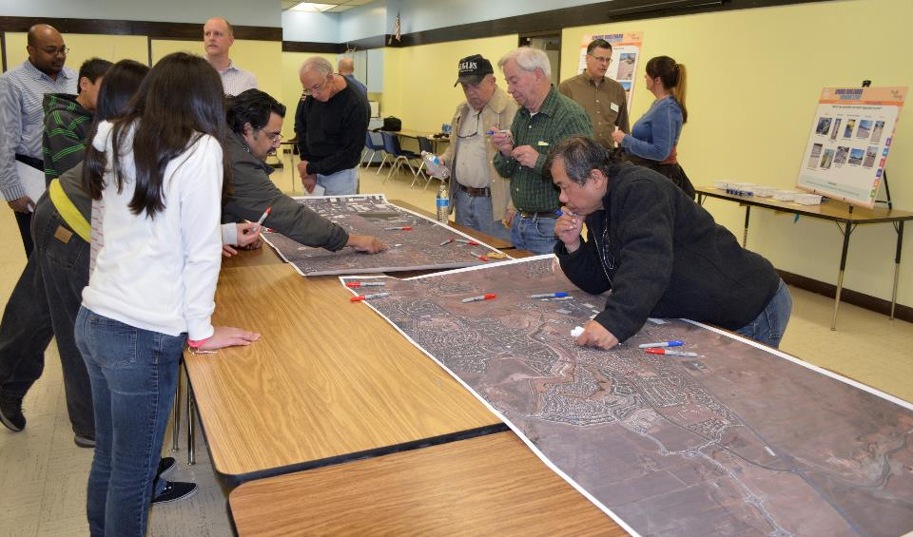
What is your Vision?
  We are seeking you input about transportation goals and priorities
  Policies & programs
  Projects & services
  Other?
Notes:
Safety Improvements – Complete Streets can improve vehicular and pedestrian safety through the introduction of traffic calming measures such as raised medians and narrower travel lanes.
Improved Mode Choice – Complete Streets tends to implement a more connected network for transit riders, pedestrians and cyclists, which improves the chances that people choose alternative modes of transportation over single occupancy vehicles.
Economic Growth – a complete street network promotes economic vitality and growth by providing better and safer access to community destinations, including residences, schools, commercial areas, and parks.
Public Health – by implementing and promoting walking and cycling improvements, the Complete Streets policy promotes active movement, which can help to reduce the obesity epidemic and support an aging population.
Reduced Congestion – by implementing and promoting alternative transportation choices, Complete Streets tend to alleviate congestion by distributing travelers amongst many modes.
Improved Air Quality – by promoting alternative trip choices, Complete Streets can have the effect of removing congestion producing single occupancy vehicle trips, helping to ease pollution concerns and promote a safer environment for travel.

